Slide 1
Brain tumor Detection and Segmentation
Karthik Bala
Data Science
Advisor: Dr.Richard Matovu

Slide 2

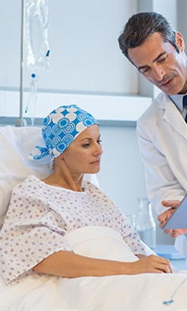
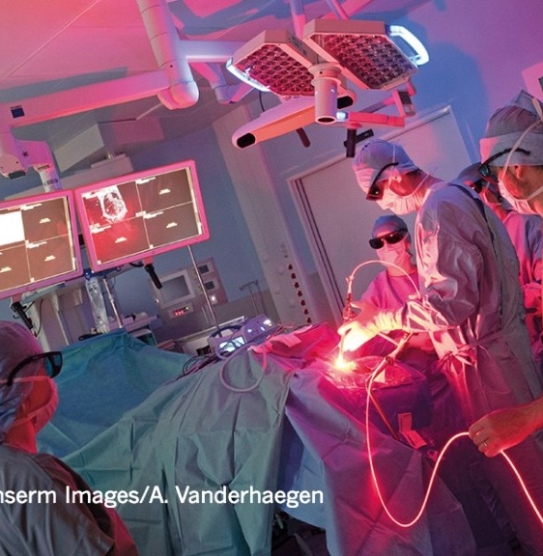
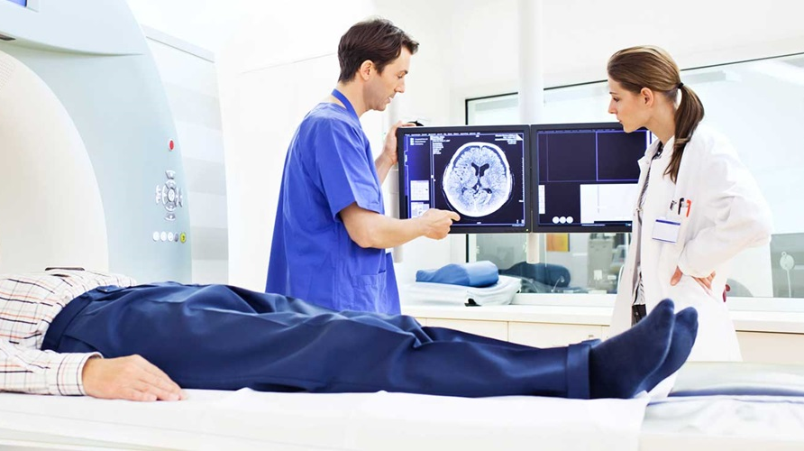
INTRODUCTION
700000 living brain tumor patients (Source: NBTS).
84,170 diagnosis in 2022.
75.2% average survival rate
MRI.

Slide 3

Problem Statement
Manual delineation.
Manual Segmentation time consuming.
Variability among the radiologist on segmentation.

Slide 4
Project Goals
Build
Build a Models (identify the tumor, Segment the tumor).
Use
Use CNN Model to Classify the Tumor present or not.
Use
Use U-Net Model to segment the tumor region.
Create
Create a website that helps to Doctor or Radiologist.

Slide 5

Dataset
BraTS dataset
Multi-Centric, Publicly available
Dimension of dataset is 240*240
Kaggle

Slide 6
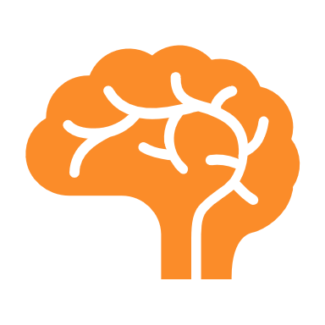
Is it really that difficult to classify MRI?
Consider the following MRI’s Can you classify them?

Slide 7
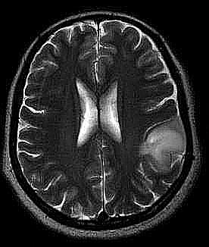
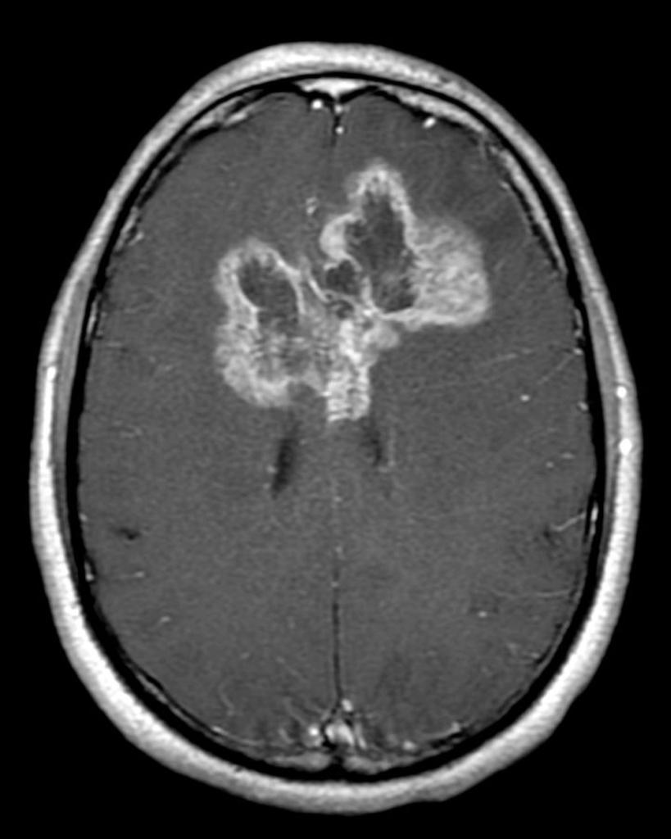
Sample Example
Picture: A
Picture: B

Slide 8
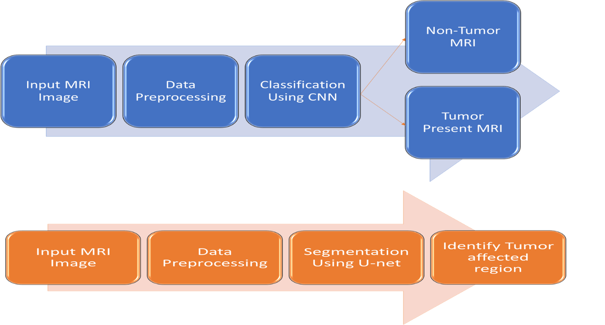
METHODOLOGY

Slide 9
Convolutional Neural Network is one of the variants of neural networks heavily in the field of computer vision
Hidden layers of a CNN typically consists of Convolutional layers, pooling layers, fully connected layers and normalization layers.
We generate models with combinations of 1,2,3 Convolution Layers: 0,1,2 dense layers with 32,64,128 nodes.
Convolution Neural Network

Slide 10
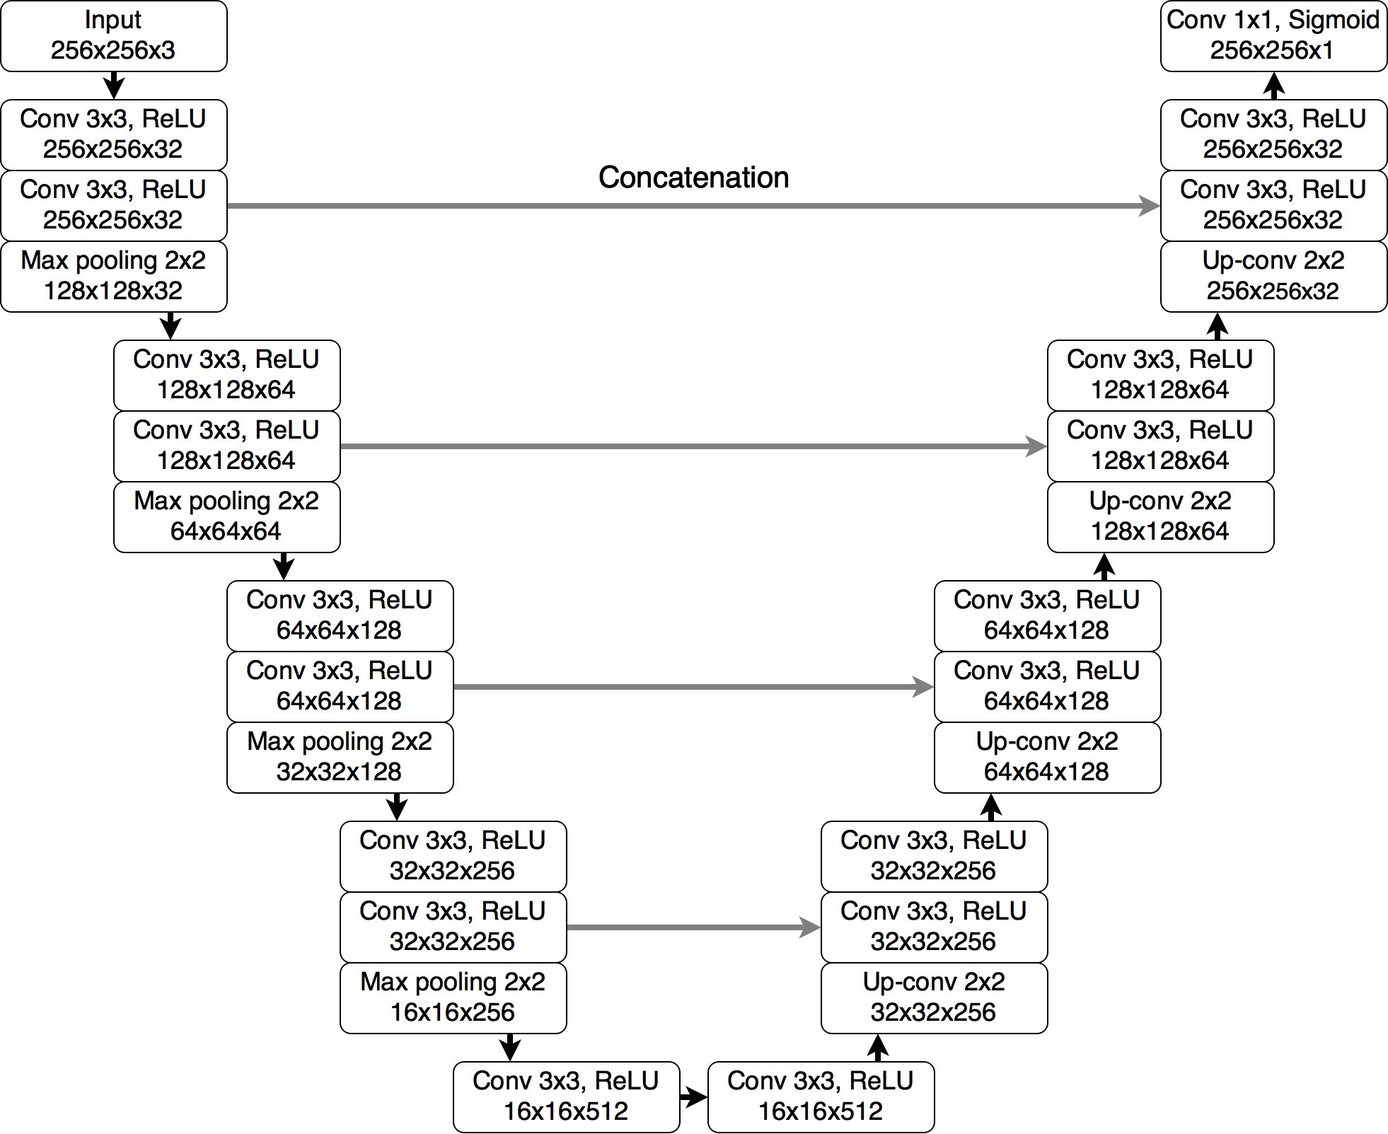
Segmentation Using U-net
U-Net model has four levels of blocks.
32,64,128 and 256 Convolutional filter.
Instance segmentation = Semantic segmentation + Object Segmentation

Slide 11

TorchVision
Pretrained Model
Reshape Layers
Optimization
Run

Slide 12

Deployment : Flask
Using Flask we built the front end of our system.
A Flask ia a python based web Framework.
Here user can upload MRI and expect output for the following applications
The flask applications runs on the local server.

Slide 13
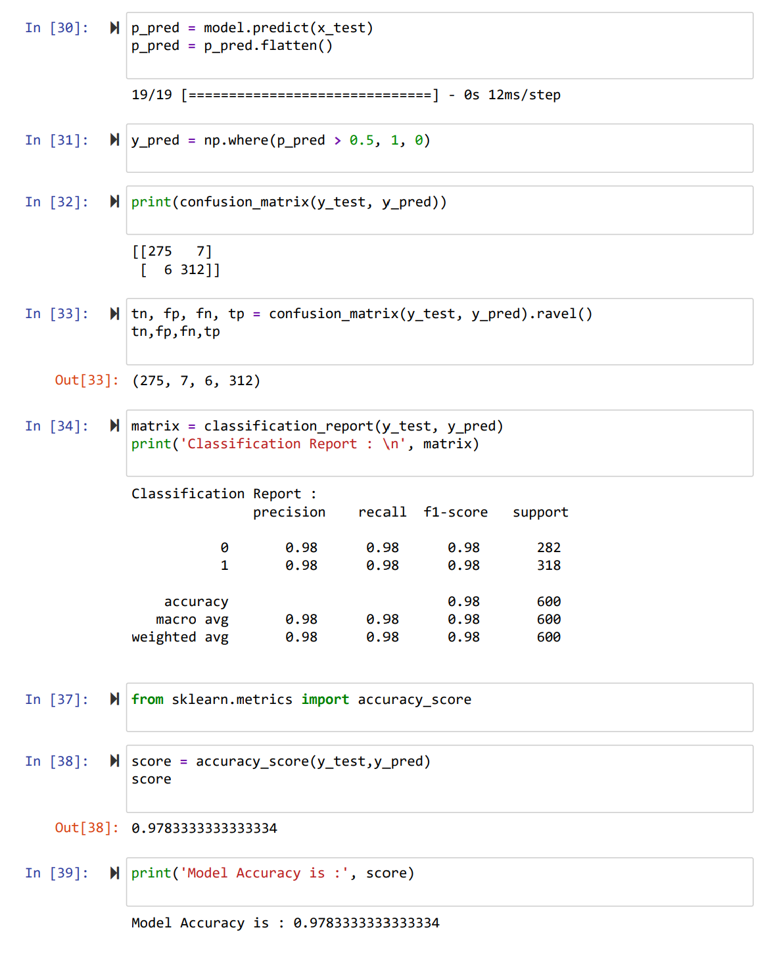
Classification Model Accuracy

Slide 14
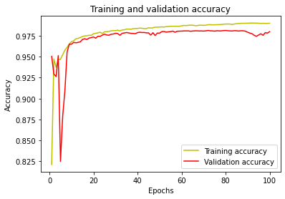
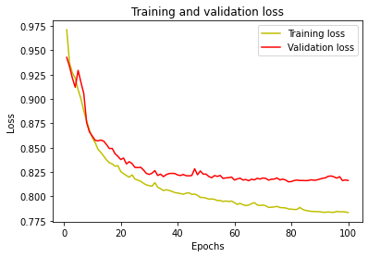
Segmentation Model Accuracy
Mean IOU – 83%

Slide 15
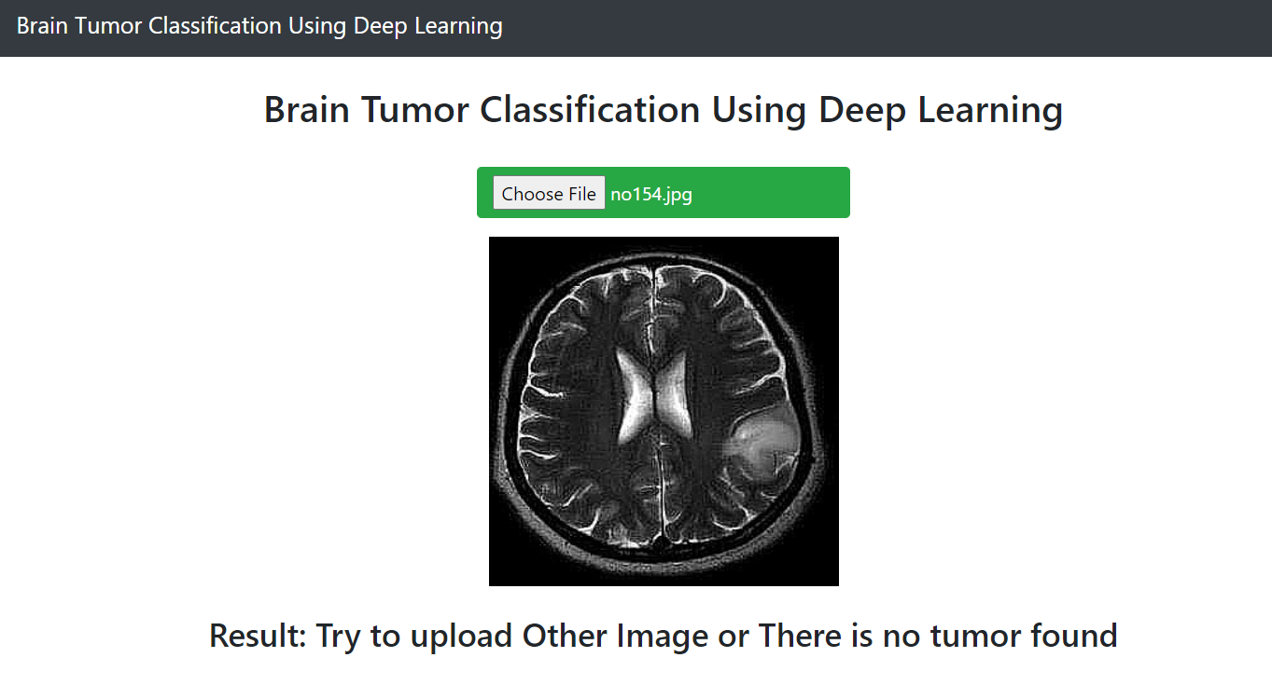
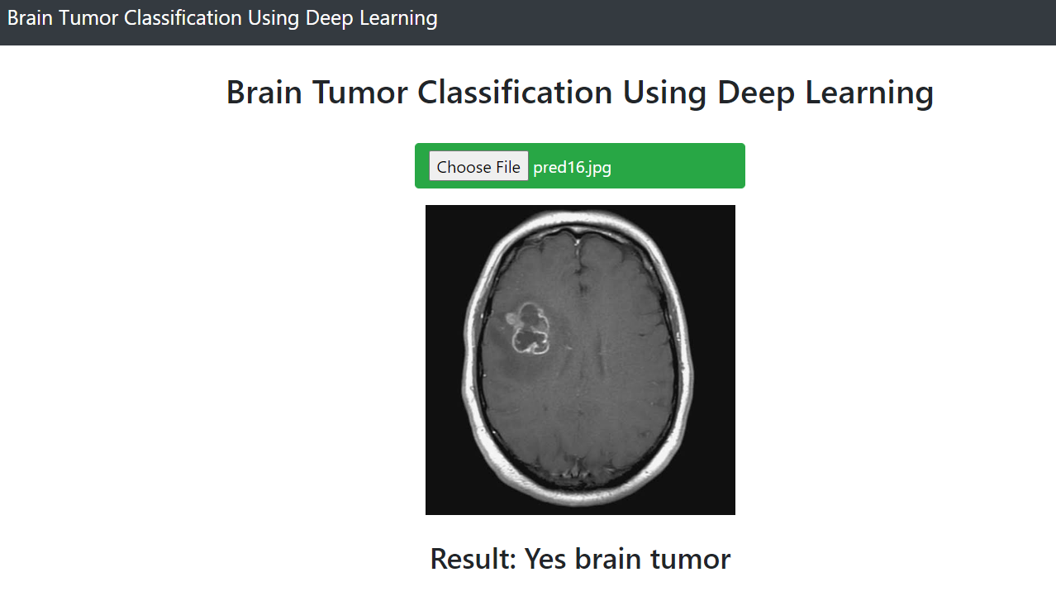
Sample CLASSIFICATION Results
Picture: A
Picture: B

Slide 16
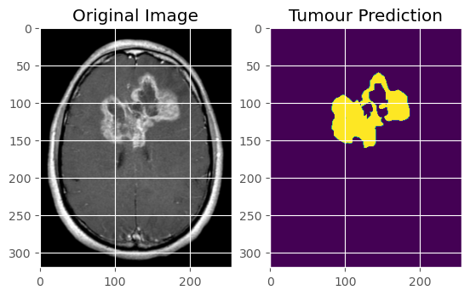
Sample Segmentation Results
Picture: B

Slide 17
Surely, they are few projects which classify MRI into tumors or not.
We trained with non-MRI images as well. If someone mistakenly upload other than MRI image that displays and say, try to upload another image.
Our Tumor Segmentation are clear and identical.
What's different

Slide 18
Conclusion
We have created deep learning models using Convolution Neural Network and U-Net.
Our Model with 98% accuracy and lowest error for web deployment
The system can be accessed by users and doctors through web browser.
Our CNN model classify the MRI Image that has the Tumor or Not.
Unet segment the MRI Image where the Tumor is present.

Slide 19
Future Scope
Tune up
Tune up the model to detect the tumor Types.
Provide
Provide feature to detect other medical condition in MRI.
Complete
Complete the system by linking doctors directly to patients.
Build
Build database to store and retrieve records.
Develop
Develop mobile app to run offline.

Slide 20
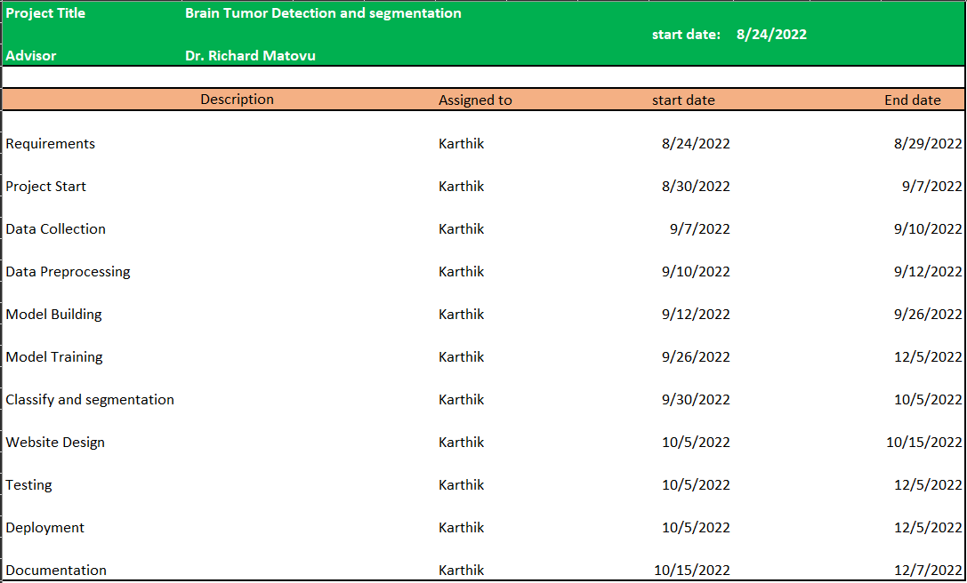
Project Timeline

Slide 21

Questions

